Slide 1
Profiling in .net
Anju munoth

Slide 2
Profiler
profiler is a tool used to help you analyze the performance of your applications to improve poorly performing code.
Profiling and diagnostics tools help you diagnose memory and CPU usage and other application-level issues.
With these tools, you can collect performance data while you run your application.
If you’re a developer who’s been on-call for your team’s codebase or you’ve written a web app, then you may have asked yourself why your app is receiving slow response times?
Often, the issues are in production, and it is challenging to investigate at that moment, but profiling tools can help you capture enough information and evidence of the issue.
There are several ways to diagnose performance issues when you’re working with APIs, but using a profiler can help you quickly identify and rule out possible causes so that you have a clear path in resolving your issue.
A profiler can help you make informed decisions quickly by providing a visual depiction of execution times and CPU usage for your application.
Much easier and quicker to understand issues and fix them when you can see a graph of the execution times or the CPU usage.

Slide 3
Profiler
Profiler can help you make informed decisions quickly by providing a visual depiction of execution times and CPU usage for your application
Tools in the Performance Profiler are intended to provide analysis for Release builds.
In the Performance Profiler, can collect diagnostic info while the app is running, and then examine the collected information after the app is stopped (a post-mortem analysis).
Open the Performance Profiler by choosing Debug > Performance Profiler (or Alt + F2).

Slide 4
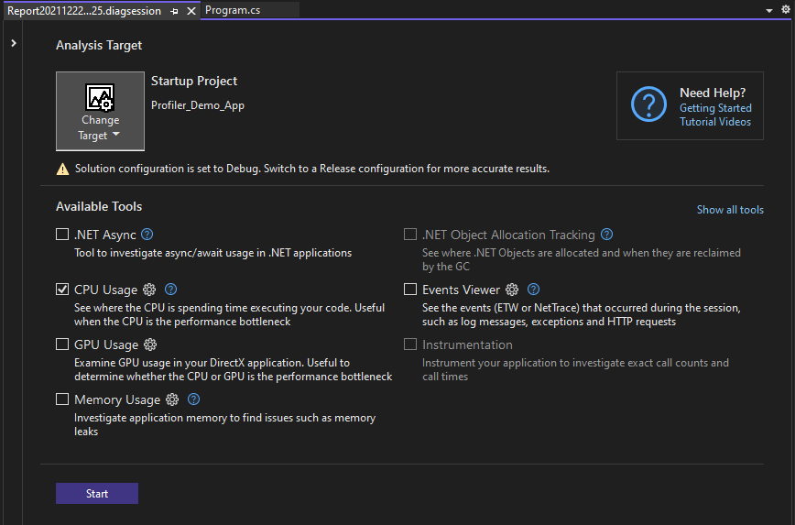

Slide 5
Profiling tools
Visual Studio offers a choice of performance measurement and profiling tools.
Some tools, like CPU Usage and Memory Usage, can run either on release builds or while debugging your app (debug build).
Tools that appear in the Diagnostics Tools window run only during a debugging session.
Tools that appear in the Performance Profiler run without the debugger, typically on release builds, and you analyze the results after you choose to stop and collect data (for post-mortem analysis).
Performance Profiler and the debugger-integrated Diagnostic Tools provide different information and experiences.
While using the Diagnostic Tools, the debugger shows you variable values and lets you use breakpoints.

Slide 6
Profiling tools
Release build performance numbers in the Performance Profiler are the most precise and accurate.
These tools give you results closer to the end-user experience.
Typically, this is the preferred method for using the profiling tools.
However, there may be scenarios where using the debugger in a debug build may help to narrow down the performance problem, especially if you want to use debugger features such as breakpoints and code stepping.

Slide 7
Performance Profiler tools
CPU usage
.NET object allocation
Memory usage
Instrumentation
.NET async tool
File I/O
.NET Counters
Database tool
GPU usage

Slide 8
Measure performance while debugging
Profiling tools that you can access during a debugging session are available in the Diagnostic Tools window.
Diagnostic Tools window appears automatically unless you have turned it off.
To bring up the window, click Debug / Windows / Show Diagnostic Tools (or press Ctrl + Alt + F2).
With the window open, you can select tools for which you want to collect data.

Slide 9
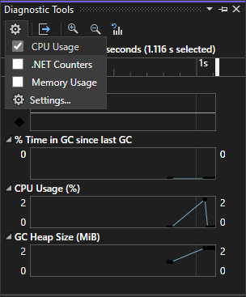
Measure performance while debugging

Slide 10
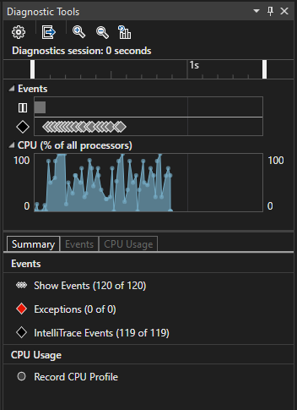
Measure performance while debugging
While you are debugging, you can use the Diagnostic Tools window to analyze CPU, memory usage, .NET counters, and you can view events that show performance-related information.

Slide 11
Analyze CPU usage
The CPU Usage tool is a good place to start analyzing your app's performance.
Tells more about CPU resources that your app is consuming.
Can use the debugger-integrated CPU Usage tool or the post-mortem CPU Usage tool.
When using the debugger-integrated CPU Usage tool, open the Diagnostics Tool window (if it's closed, choose Debug / Windows / Show Diagnostic Tools).
While debugging, open the Summary view, and select Record CPU Profile.

Slide 12
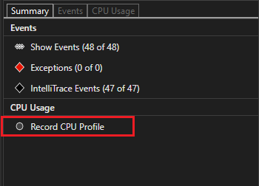
Analyze CPU usage

Slide 13
Analyze CPU usage
One way to use the tool is to set two breakpoints in your code, one at the beginning and one at the end of the function or the region of code you want to analyze.
Examine the profiling data when you are paused at the second breakpoint.
CPU Usage view shows you a list of functions ordered by longest running, with the longest running function at the top under Top Functions.
Hot Path section shows you the call stack for the functions that are using the most CPU.
These lists can help guide you to functions where performance bottlenecks are happening.

Slide 14
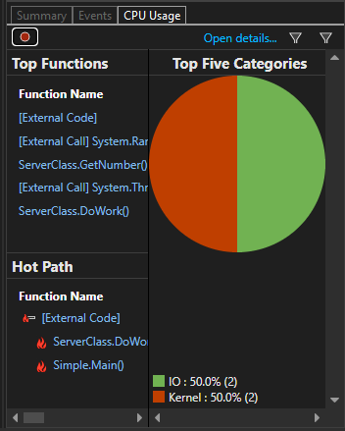
Analyze CPU usage

Slide 15
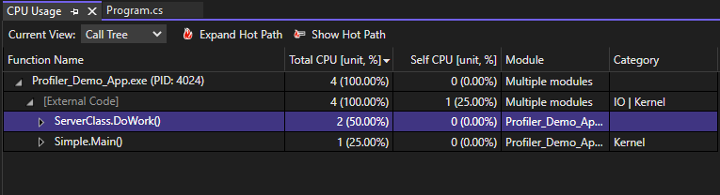
Analyze CPU usage
Click on a function that you are interested in, and you will see a more detailed Call tree view, with the selected function highlighted.
The table shows columns with data such as the time spent in the function, including called functions (Total CPU), and a second column that shows the time spent in a function, excluding called functions (Self CPU).
This data can help you evaluate whether the function itself is a performance bottleneck.

Slide 16
Analyze memory usage
Diagnostic Tools window also allows you to evaluate memory usage in your app using the Memory Usage tool.
For example, you can look at the number and size of objects on the heap.
Can use the debugger-integrated Memory Usage tool or the post-mortem Memory Usage tool in the Performance Profiler.
.NET developers may choose between either the .NET Object Allocation tool or the Memory usage tool.

Slide 17
Analyze memory usage
.NET Object Allocation tool helps you identify allocation patterns and anomalies in your .NET code, and helps identify common issues with garbage collection.
This tool runs only as a post-mortem tool. You can run this tool on local or remote machines.
Memory usage tool is helpful in identifying memory leaks, which are not typically common in .NET apps.
If you need to use debugger features while checking memory, such as stepping through code, the debugger-integrated Memory usage tool is recommended.
To analyze memory usage with the Memory Usage tool, you need to take at least one memory snapshot.
Often, the best way to analyze memory is to take two snapshots; the first right before a suspected memory issue, and the second snapshot right after a suspected memory issue occurs.
Then you can view a diff of the two snapshots and see exactly what changed.

Slide 18
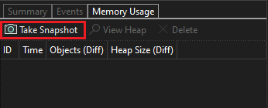
Analyze memory usage

Slide 19
Analyze memory usage
When you select one of the arrow links, you are given a differential view of the heap (a red up arrow Memory Usage Increase shows an increasing object count (left) or an increasing heap size (right)).
If you click the right link, you get a differential heap view ordered by objects that increased the most in heap size.
This can help you pinpoint memory problems.
For example, in the illustration in the next slide, the bytes used by ClassHandlersStore objects increased by 3,492 bytes in the second snapshot.
If you click the link on the left instead in the Memory Usage view, the heap view is organized by object count; the objects of a particular type that increased the most in number are shown at the top (sorted by Count Diff column).

Slide 20
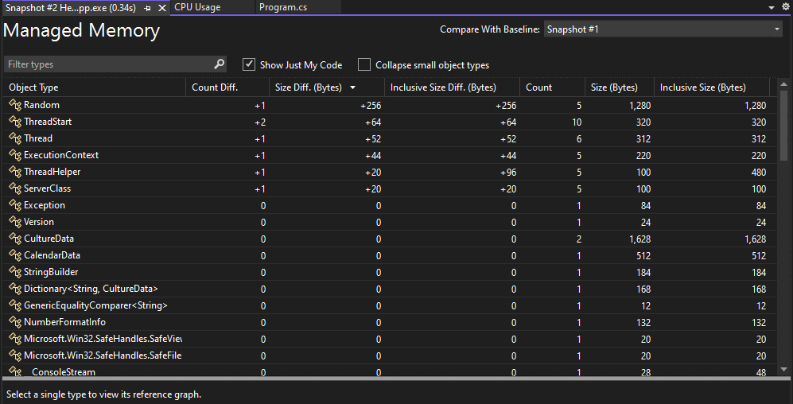

Slide 21
Instrumentation
Instrumentation tool is similar to the CPU Usage tool, except that it provides exact call counts and wall clock time instead of CPU utilization.
Instrumentation method requires more overhead than the CPU Usage tool.
This tool is available in the Performance Profiler. Open the Performance Profiler by choosing Debug > Performance Profiler (or Alt + F2).

Slide 22
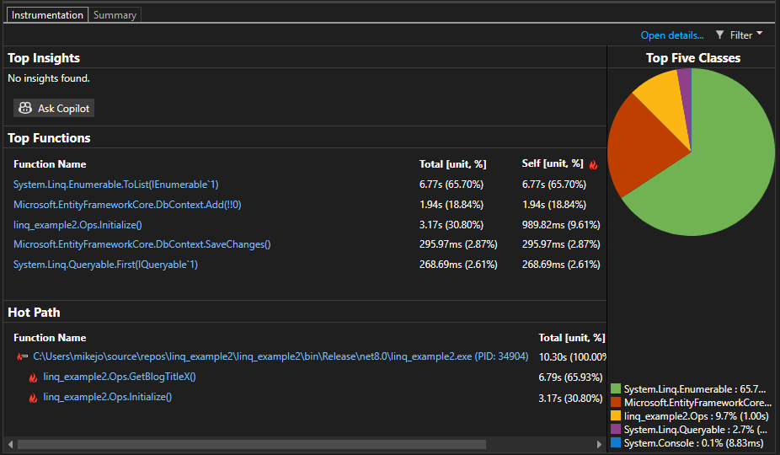

Slide 23
Examine File I/O
File I/O tool helps you understand how you can optimize your File I/O operations to improve performance in your apps.
If you’re trying to investigate and diagnose slow loading times, the new File IO tool can help you understand how the I/O operations impact your spent time.
This tool is available in the Performance Profiler. Open the Performance Profiler by choosing Debug > Performance Profiler (or Alt + F2).
The tool shows file read and file write operations in a tabbed list view.

Slide 24
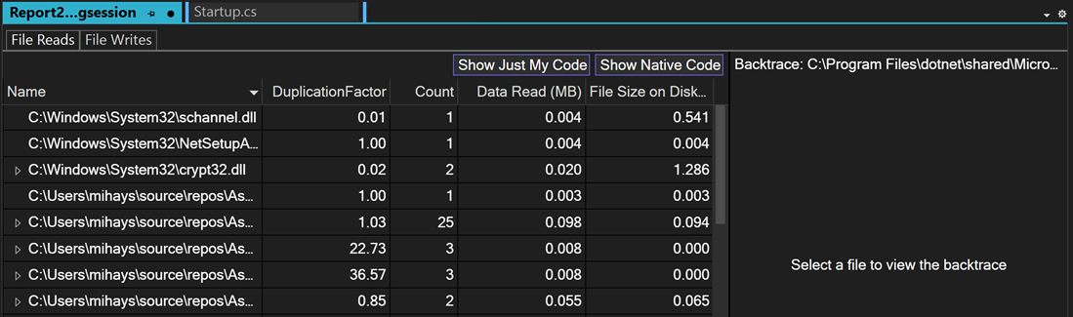
Examine File I/O

Slide 25
Examine performance using PerfTips
Often, the easiest way to view performance information is to use PerfTips.
Using PerfTips, you can view performance information while interacting with your code.
Ccan check information such as the duration of the event (measured from when the debugger was last paused, or when the app started).
For example, if you step through code (F10, F11), PerfTips show you the app runtime duration from the previous step operation to the current step.
Ccan use PerfTips to examine how long it takes for a code block to execute, or how long it takes for a single function to complete.
PerfTips show the same events that also show up in the Events view of the Diagnostic Tools.
In the Events view, you can view different events that occur while you are debugging, such as the setting of a breakpoint or a code stepping operation.

Slide 26
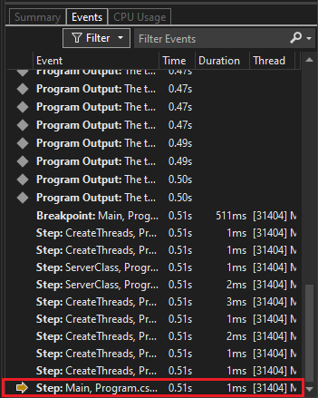
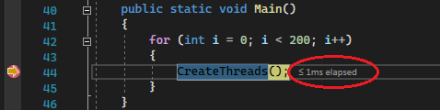

Slide 27
Visualize .NET counters (.NET)
Starting in Visual Studio 2019 version 16.7, you can use the .NET Counters tool in Visual Studio to visualize performance counters.
Can visualize counters created using dotnet counters. dotnet counters supports many counters such as CPU usage and garbage collector heap size.
Tool shows live values for each counter in a list view.

Slide 28
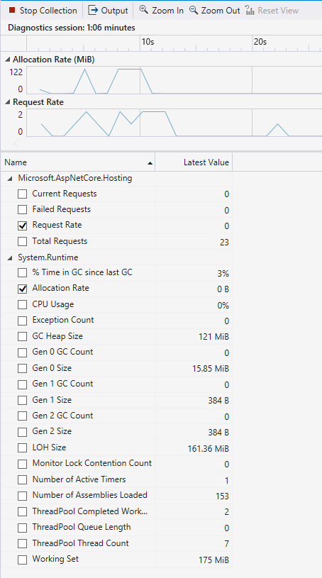

Slide 29
Examine application events
The generic events viewer allows you to view the activity of your application through a list of events, such as module load, thread start, and system configurations, to help better diagnose how your application is performing right within the Visual Studio profiler.
This tool is available in the Performance Profiler. Open the Performance Profiler by choosing Debug > Performance Profiler (or Alt + F2).
The tool shows each event in a list view.
Columns provide information about each event, such as the event name, timestamp, and process ID.

Slide 30
Performance Tool | Description | When to use the tool?
CPU Usage | Shows where the CPU is spending time. | • Begin an investigation for general performance issues. • Investigate high server CPU usage. • Investigate DevOps scenarios, such as when orders are not getting through to the retail website. • Optimize CPU usage. • Investigate latency in API calls.
Flame graph | View within the CPU Usage tool that provides an alternate visualization of the call tree. | Investigate latency in API calls
Hot path | View within the CPU Usage tool that shows where most of the CPU time was spent in your application. | Investigate latency in API calls
Memory Usage | Shows your app’s memory to find issues such as memory leaks. | • Optimize memory usage • Investigate UI freeze • Investigate suspected memory leak (native code)

Slide 31
Performance Tool | Description | When to use the tool?
.NET Object Allocation | Shows where .NET Objects are allocated and information about garbage collection. | • Optimize .NET memory usage • Analyze garbage collection
Instrumentation | Shows exact call counts and call times. | • You need a tool like CPU Usage, but you want exact call counts and time spent in functions based on wall clock time. • You want to see blocked time, such as time spent waiting for locks. • Note: This tool requires extra overhead.
File I/O | Shows your File I/O operations and how long they take and how much data they process. | Investigate UI freeze
PerfTips | Shows a quick measurement of performance information while interacting with your code. | While debugging, you want to see the elapsed time between the previous step operation (or breakpoint) to the current step or breakpoint.

Slide 32
Performance Tool | Description | When to use the tool?
.NET Async | Shows async/await usage in .NET apps. | Investigate suspected performance issue with asynchronous code.
.NET Counters | Live report for .NET counters. | • Begin an investigation for general performance issues. • You want a trace for .NET counter-based metrics such as exceptions per second, garbage collection, and CPU utilization.
Database | Shows performance of your database queries. | Investigate performance for database queries that use either ADO.NET or Entity Framework Core.
GPU Usage | Shows high-level hardware usage of your Direct3D app. | Check whether the performance of your app is CPU-bound or GPU-bound.

Slide 33
Which tools are supported for my project?
Performance Tool | .NET | C/C++ | ASP.NET/ASP.NET Core
CPU Usage | yes | yes | yes
Memory Usage | yes | yes | yes
.NET Object Allocation | yes | no | yes
Instrumentation | yes | yes | yes
File I/O | yes | yes | yes
PerfTips | yes | yes | yes
Events viewer | yes | yes | yes
.NET Async | yes | no | yes

Slide 34
Which tools are supported for my project?
Performance Tool | .NET | C/C++ | ASP.NET/ASP.NET Core
.NET Counters | yes (.NET Core/5+ only) | no | yes (ASP.NET Core only)
Database | yes (.NET Core/5+ only) | no | yes (ASP.NET Core only)
GPU Usage | yes | yes | no
Application Timeline | yes (XAML) | no | no
Performance Explorer | no | no | no
IntelliTrace | .NET with Visual Studio Enterprise only | no | .NET with Visual Studio Enterprise only

Slide 35
Release or debug – When to use profiler
To help you decide between using the profiling tools in release or debug builds, consider the following:
Release builds provide optimizations like inlining function calls and constants, pruning unused code paths, and storing variables in ways that can't be used by the debugger.
Performance numbers in debug builds are less accurate, because debug builds lack these optimizations.
In addition to differences between release builds and debug builds, the debugger itself changes performance times, as it does necessary debugger operations like intercepting exception and module load events.
For performance problems caused by CPU-intensive calls, there might be considerable performance differences between release and debug builds. Check to see whether the CPU performance issue exists in release builds.
External performance problems, like file I/O or network responsiveness issues, won't look much different in a release build or a debug build.
If the problem occurs only with debug builds, you probably don't need to run the tools with release builds.
Some tools, such as the .NET Object Allocation tool, are only available in the Performance Profiler (non-debugger scenarios).

Slide 36
Collect profiling data on release builds
With a project open in Visual Studio, set the solution configuration to Release, and select Local Windows Debugger (or Local Machine) as the deployment target.
Select Debug > Performance Profiler, or press Alt+F2.
On the diagnostic tools launch page, select one or more tools to run. Only the tools that are applicable to the project type, operating system, and programming language are shown. Select Show all tools to also see tools that are disabled for this diagnostic session.

Slide 37
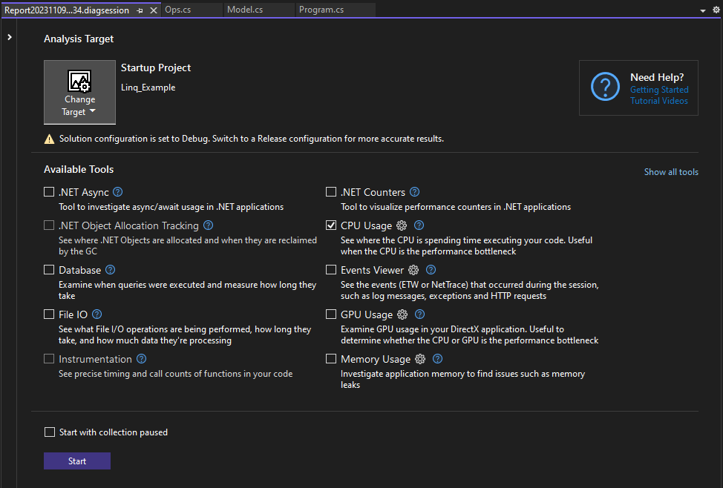

Slide 38
Collect profiling data on release builds
To start the diagnostic session, select Start.
While the session is running, some tools show graphs of real-time data on the diagnostic tools page, and might show options to pause and resume data collection.
To end the diagnostic session, select Stop Collection.
The analyzed data appears on the Report page.

Slide 39
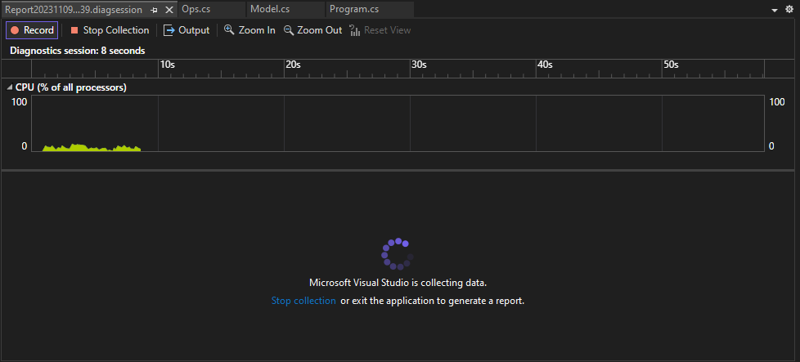

Slide 40
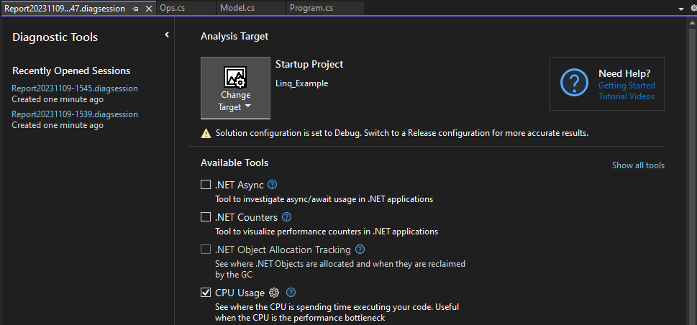
(Optional) Save the report, and then you can open it later from the Recently Opened Sessions list on the Diagnostic Tools launch page.

Slide 41
Collect profiling data while debugging
When you start debugging in Visual Studio by selecting Debug > Start Debugging, or pressing F5, the Diagnostic Tools window appears by default.
To open it manually, select Debug > Windows > Show Diagnostic Tools.
Diagnostic Tools window shows information about events, process memory, CPU usage, and .NET Counters.
Use the Settings icon in the toolbar to select whether to view CPU Usage, Memory Usage, or .NET Counters.
Select Settings in the Settings drop-down list to open the Diagnostic Tools Property Pages with more options.
If you're running Visual Studio Enterprise, you can enable or disable IntelliTrace by going to Tools > Options > IntelliTrace.
The diagnostic session ends when you stop debugging.

Slide 42
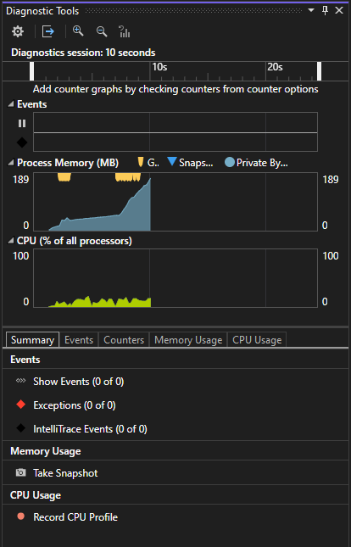

Slide 43
Events tab
During a debugging session, the Events tab of the Diagnostic Tools window lists the diagnostic events that occur.
The category prefixes Breakpoint, File, and others, let you quickly scan the list for a category, or skip the categories you don't care about.
Use the Filter drop-down list to filter events in and out of view, by selecting or clearing specific categories of events.

Slide 44
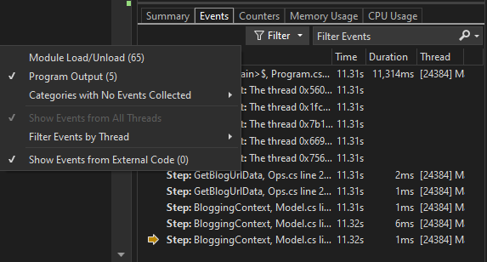
Events tab

Slide 45
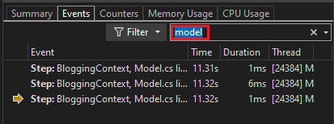
Events tab
Use the search box to find a specific string in the event list. Here are the results of a search for the file name model that matched three events:

Slide 46
Optimization case study
Sample application examined in this case study is a .NET application that runs queries against a database of blogs and blog posts.
Utilizes the Entity Framework, a popular ORM (Object-Relational Mapping) for .NET, to interact with a SQLite local database.
Application is structured to execute a large number of queries, simulating a real-world scenario where a .NET application might be required to handle extensive data retrieval tasks.
The primary performance issue with the sample application lies in how it manages compute resources and interacts with the database.
Application has a performance bottleneck that significantly impacts its efficiency and, consequently, the compute costs associated with running it.

Slide 47
Optimization case study
Problem includes the following symptoms:
High CPU Usage: Applications may perform inefficient computations or processing tasks in a way that unnecessarily consumes a large amount of CPU resources.
Can lead to slow response times and increased operational costs.
Inefficient Memory Allocation: Applications can sometimes face issues related to memory usage and allocation. In .NET apps, inefficient memory management can lead to increased garbage collection, which in turn can affect application performance.
Database Interaction Overheads: Applications that execute a large number of queries against a database can experience bottlenecks related to database interactions.
This includes inefficient queries, excessive database calls, and poor use of Entity Framework capabilities, all of which can degrade performance.

Slide 48
Optimization case study
case study aims to address these issues by employing Visual Studio's profiling tools to analyze the application's performance.
By understanding where and how the application's performance can be improved, developers can implement optimizations to reduce CPU usage, improve memory allocation efficiency, streamline database interactions, and optimize resource utilization.
The ultimate goal is to enhance the application's overall performance, making it more efficient and cost-effective to run.

Slide 49
Strategy
Here is a high-level view of the approach in this case study:
We start the investigation by taking a CPU usage trace. Visual Studio's CPU Usage tool is often helpful to begin performance investigations and to optimize code to reduce cost.
Next, to get additional insights to help isolate issues or improve the performance, we collect a trace using one of the other profiling tools. For example:
We take a look at the memory usage. For .NET, we try the .NET Object Allocation tool first.
For ADO.NET or Entity Framework, we can use the Database tool to examine SQL queries, precise query time, and more.

Slide 50
Data collection requires the following tasks:
Setting the app to a Release build.
Selecting the CPU Usage tool from the Performance Profiler (Alt+F2). (Later steps involve a few of the other tools.)
From the Performance Profiler, start the app and collect a trace.

Slide 51
CPU Usage tool
Diagnose a slow-down or a process hang in your team’s codebase.
Tool can help diagnose the issue with your team’s production code.
Provides automatic insights and various views of your data so that you can analyze and diagnose performance issues.
Identify performance issues in DevOps scenarios
Help when a customer reports that some requests or orders are not getting through to the retail website during peak season.
Often, the issues are in production, and it is challenging to debug at that moment, but this tool can help you capture enough information and evidence of the issue.
After collecting a trace file, the analysis can quickly help you understand potential causes and give suggestions within the context of your code so that you can take the next steps to fix the issue.

Slide 52
CPU Usage tool
Check for high CPU utilization
If your latency issue isn’t within an API request, then you can check for high CPU utilization and other related issues with the CPU Usage tool.
CPU Usage tool can help you identify bottlenecks so that you can narrow down where to optimize.

Slide 53
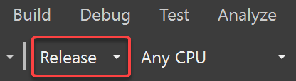
Collect CPU utilization data
In the Visual Studio project, set the solution configuration to Release and select the deployment target.
The deployment target typically matches the project name, indicating a local deployment.
Select Debug > Performance Profiler.
Under Available tools, select CPU Usage, and then select Start.
If you enable the Start with collection paused option before starting the profiler, data will not be collected until you select the Record button in the diagnostic session view.

Slide 54
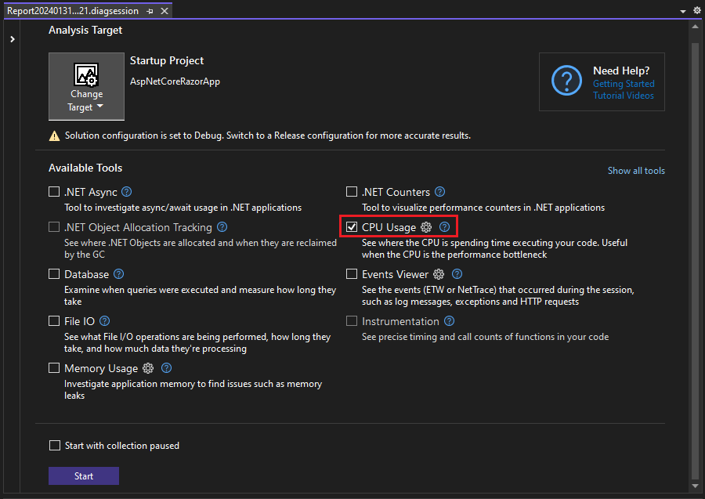

Slide 55
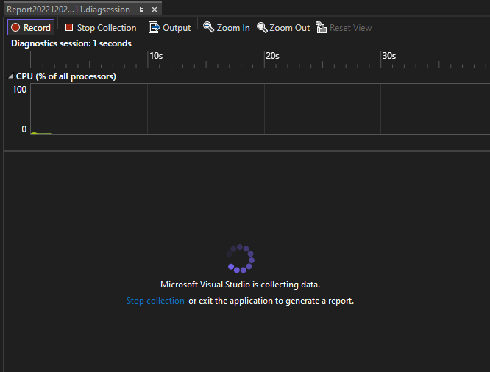
After the app starts, the diagnostic session begins and displays CPU utilization data. When you're finished collecting data, select Stop Collection.

Slide 56
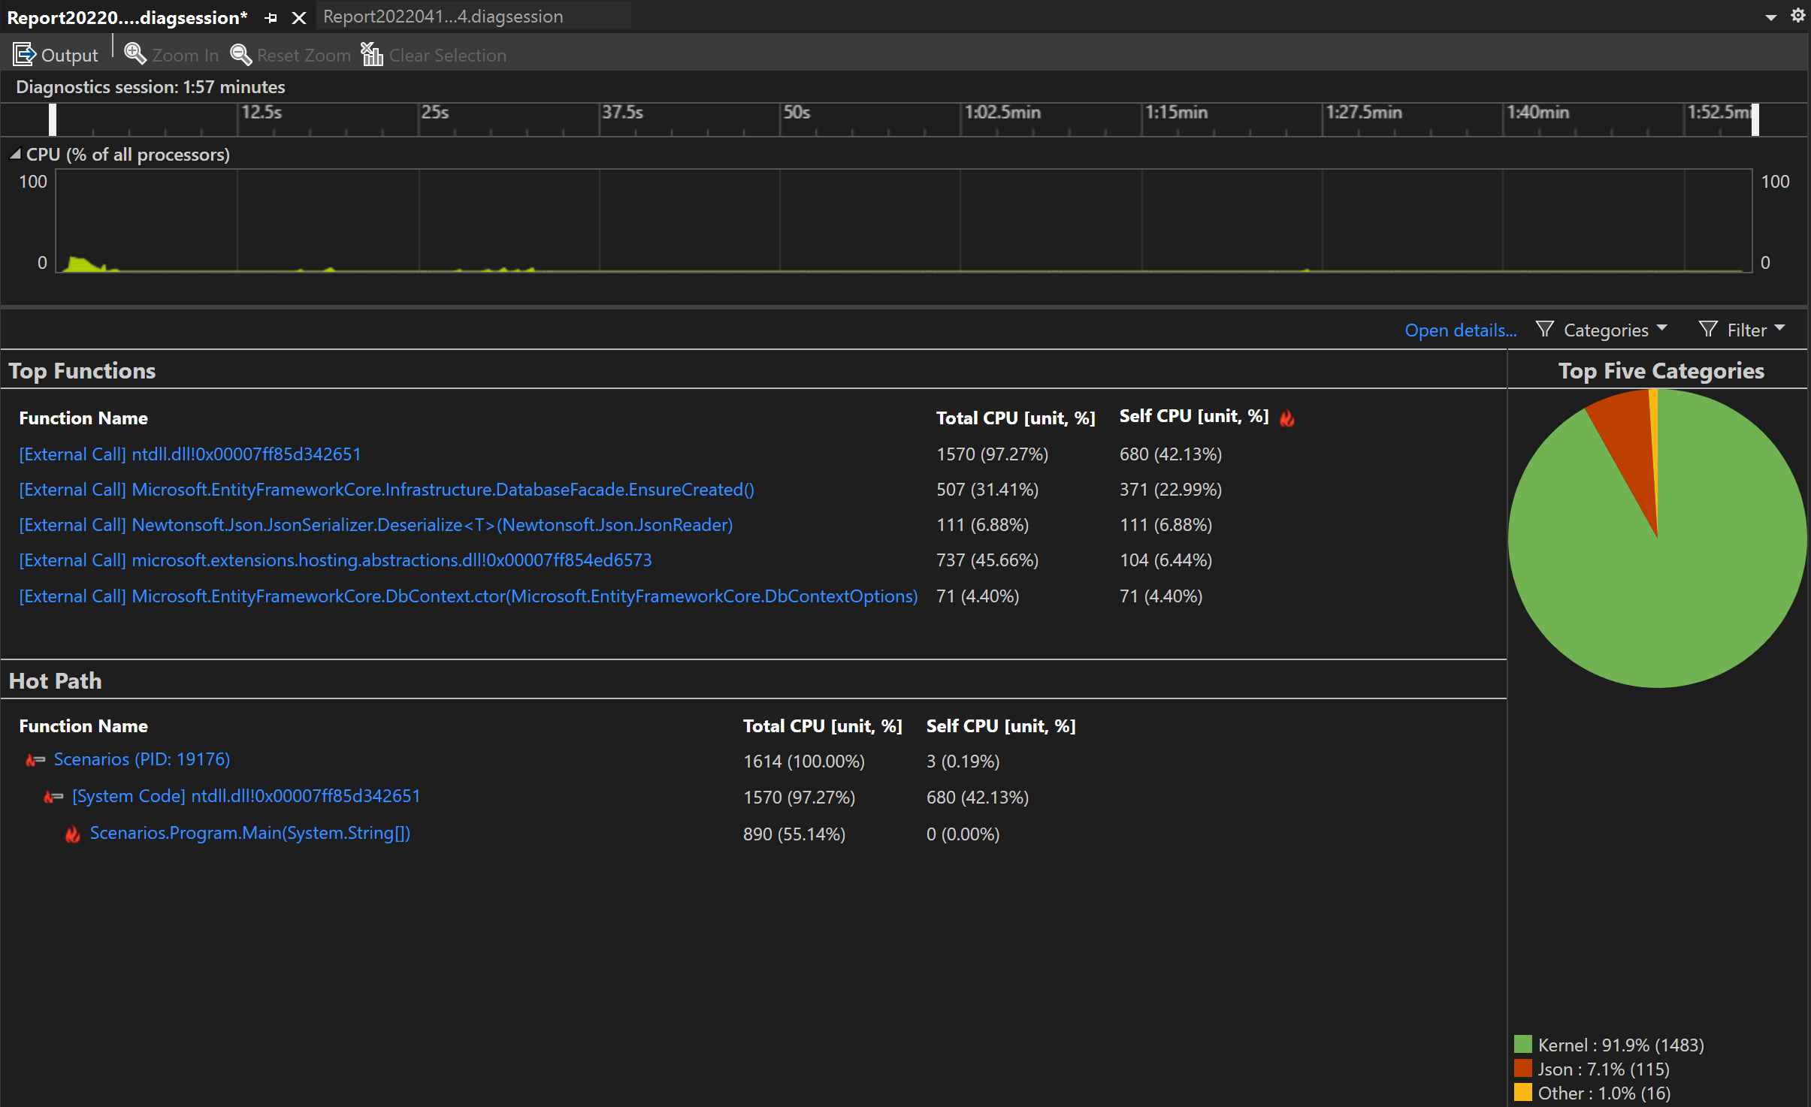
The CPU Usage tool analyzes the data and displays the report

Slide 57
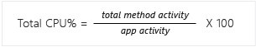
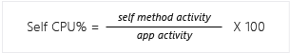
CPU utilization data columns
Name | Description
Total CPU [unit, %] | Milliseconds of CPU computation time and the CPU percentage used by calls to the function, and functions called by the function, in the selected time range. This is different from the CPU Utilization timeline graph, which compares the total CPU activity in a time range to the total available CPU.
Self CPU [unit, %] | Milliseconds of CPU computation time and the CPU percentage used by calls to the function in the selected time range, excluding functions called by the function.
Module | In some views, the Module column is shown, which shows the name of the module containing the function.

Slide 58
Analyze CPU utilization
View | Description
Caller/callee | Detailed view of CPU time for a specific function, the function(s) that called it, and the function(s) that it calls. The performance data is aggregated for the data collection period. You can select calling functions and called functions to traverse the call path.
Call tree | Hierarchical view of the function call path. Used to identify call paths that are taking the most CPU time (hot path).
Modules | View of the CPU time spent in individual modules, aggregated over the data collection period. Used to identify modules that might be performance bottlenecks due to a combination of high call counts and/or performance issues.
Functions | View of the CPU time spent in individual functions, aggregated over the data collection period. Used to identify functions that might be performance bottlenecks due to a combination of high call counts and/or performance issues.
Flame graph | Hierarchical view of the function call path in a flame graph visualization. Used to identify call paths that are taking the most CPU time (hot path).

Slide 59
Analyze CPU utilization
In all views except Caller/callee, the diagnostic report is sorted by Total CPU, from highest to lowest.
Change the sort order or sort column by selecting the column headers.
Can double-click on a function that you are interested in, and you will see the source for the function as well as highlighting that shows where time is spent in that function.
Table shows columns with data such as the time spent in the function, including called functions (Total CPU), and a second column that shows the time spent in a function, excluding called functions (Self CPU).
This data can help you assess whether the function itself is a performance bottleneck.
Determine how much data the method is displaying to see if third-party code or runtime libraries are the reason for your endpoints being slow or resource-consumption heavy.

Slide 60
CPU Usage call tree
To view the call tree, select the parent node in the report. By default, the CPU Usage page opens to the Caller/Callee view.
In the Current View dropdown, select Call Tree.
Can click the Expand Hot Path and Show Hot Path buttons to see the function calls that use the highest percentage of the CPU in the call tree view.

Slide 61
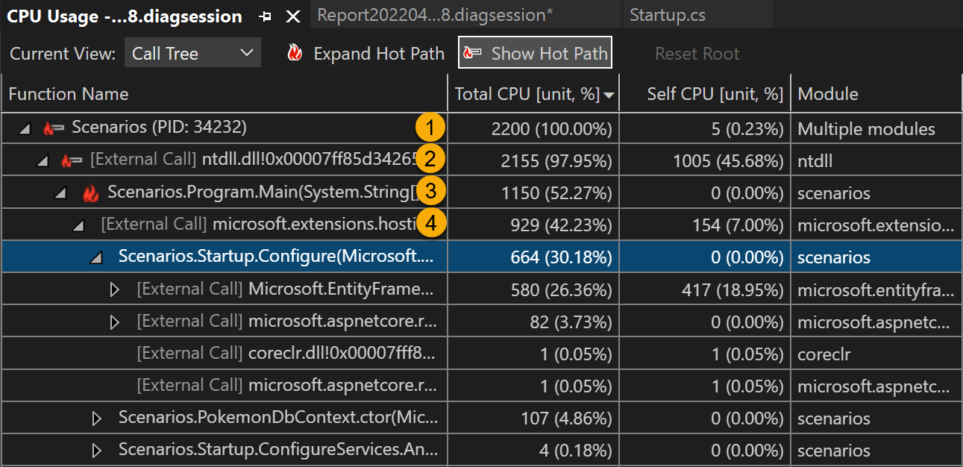

Slide 62
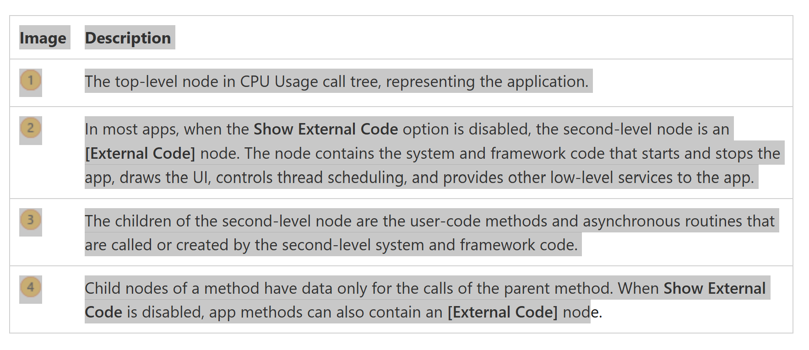

Slide 63
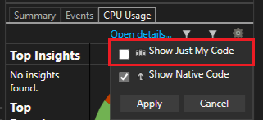
External code
System and framework functions that are executed by your code are called external code.
External code functions start and stop the app, draw the UI, control threading, and provide other low-level services to the app.
In most cases, you aren't interested in external code, so the CPU Usage call tree gathers the external functions of a user method into one [External Call] node.
To view the call paths of external code, on the main report summary page (right pane), deselect Show Just My Code from the Settings dropdown, and then select Apply.
The Settings dropdown is available on the main report summary page, not the detailed views.

Slide 64
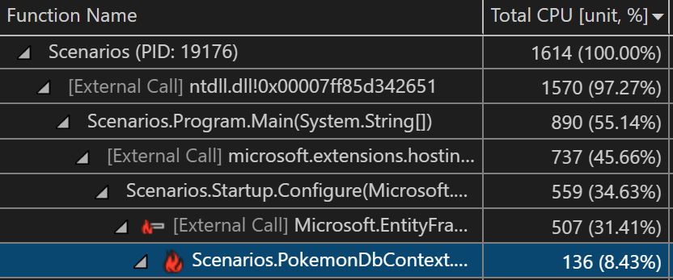
External code
When you disable Show Just My Code, the Call Tree view of the CPU Usage page expands the external code calls.
Many external code call chains are deeply nested, so the width of the chain can exceed the display width of the Function Name column.
The function names then appear as shown in the image.

Slide 65
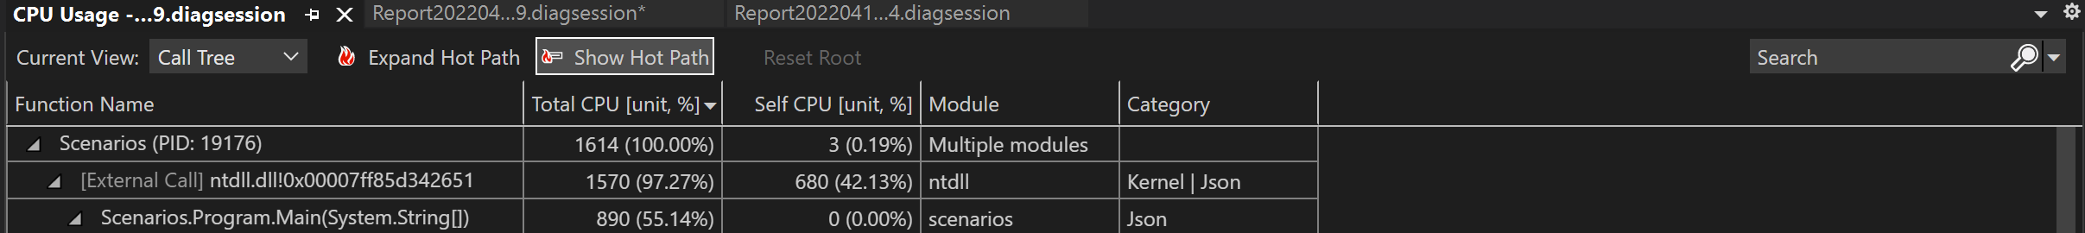
External code
To find a function name you're looking for, use the search box. Hover over the selected line or use the horizontal scroll bar to view the data.

Slide 66
Asynchronous functions in the CPU usage call tree
When the compiler encounters an asynchronous method, it creates a hidden class to control the method's execution.
Conceptually, the class is a state machine.
The class has compiler-generated functions that asynchronously call the original methods, and the callbacks, scheduler, and iterators needed to run them.
When a parent method calls the original method, the compiler removes the method from the execution context of the parent, and runs the hidden class methods in the context of the system and framework code that controls app execution.
The asynchronous methods are often, but not always, executed on one or more different threads.
This code appears in the CPU Usage call tree as children of the [External Code] node immediately below the top node of the tree.

Slide 67
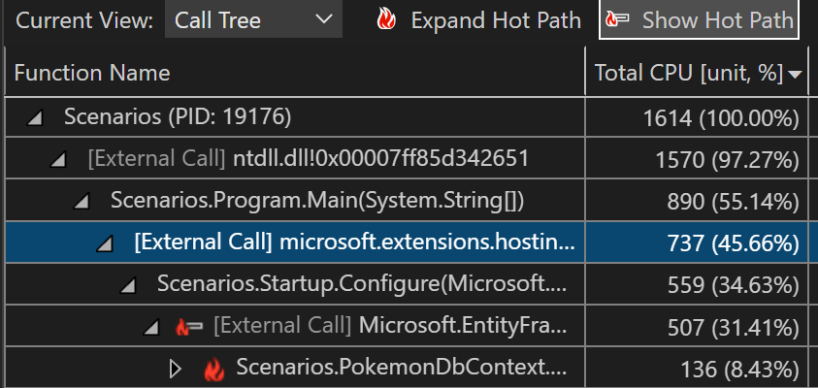

Slide 68
Identify hot paths with a flame graph
Visual Studio profiling tools for CPU utilization and instrumentation include the Flame Graph view.
Flame Graph helps you identify hot paths in your code by showing a visualization of the call tree.
The hot path is the call stack for the functions that are using the most CPU or the most time, and is often a good place to look for potential performance optimizations.
The graph gives a visual overview of where time is being spent in your application and you can click on specific nodes to dig into them further.

Slide 69
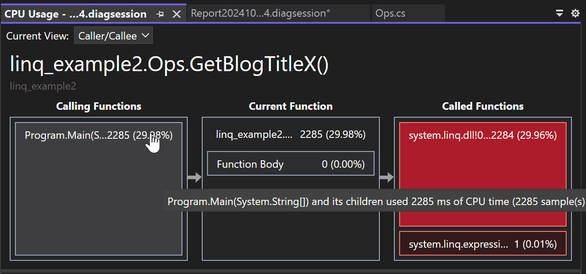

Slide 70
Investigate hot paths
The Flame Graph view is in the details view of .diagession report.
Start a profiling session with either the CPU Usage or Instrumentation tool.
After you've stopped your profiling session and the report loads, select Open details.

Slide 71
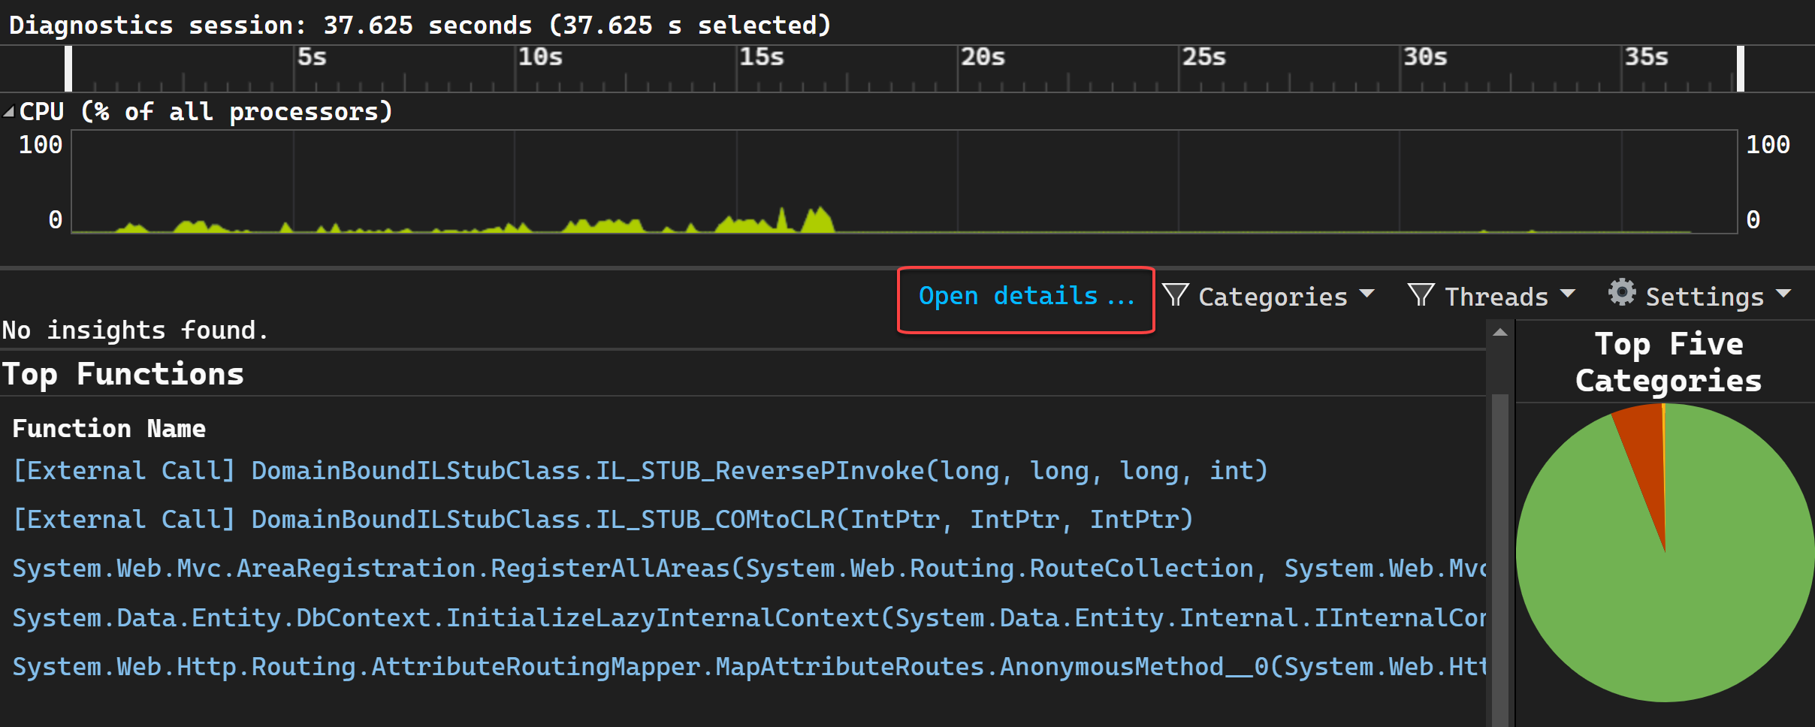

Slide 72
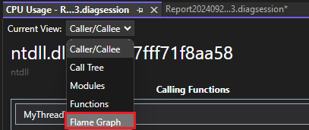
Select Flame Graph in the Current View dropdown selection.

Slide 73
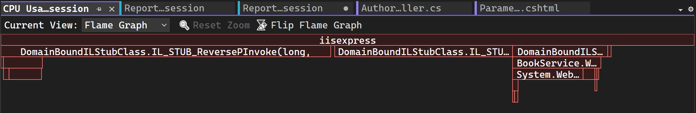
Flame Graph view appears.

Slide 74
hot path is the code path using the most CPU or the most time as you look downward through the call tree.
By default, the data shown in the Flame Graph represents the same data as shown in the Call tree view for the data collection period.
Specifically, for CPU Usage, it shows the Total CPU values.
This value is inclusive, so it includes CPU utilization (that is, CPU computation time) used by calls to the function, and any other functions called by the function.
In the same way, for Instrumentation, the graph shows the values equivalent to the Total column in the call tree view.

Slide 75
If you select a node, the selected node becomes the new baseline and uses 100% of the flame graph width.
This allows you to better visualize a complex call tree and view long names when they're truncated or hidden.

Slide 76
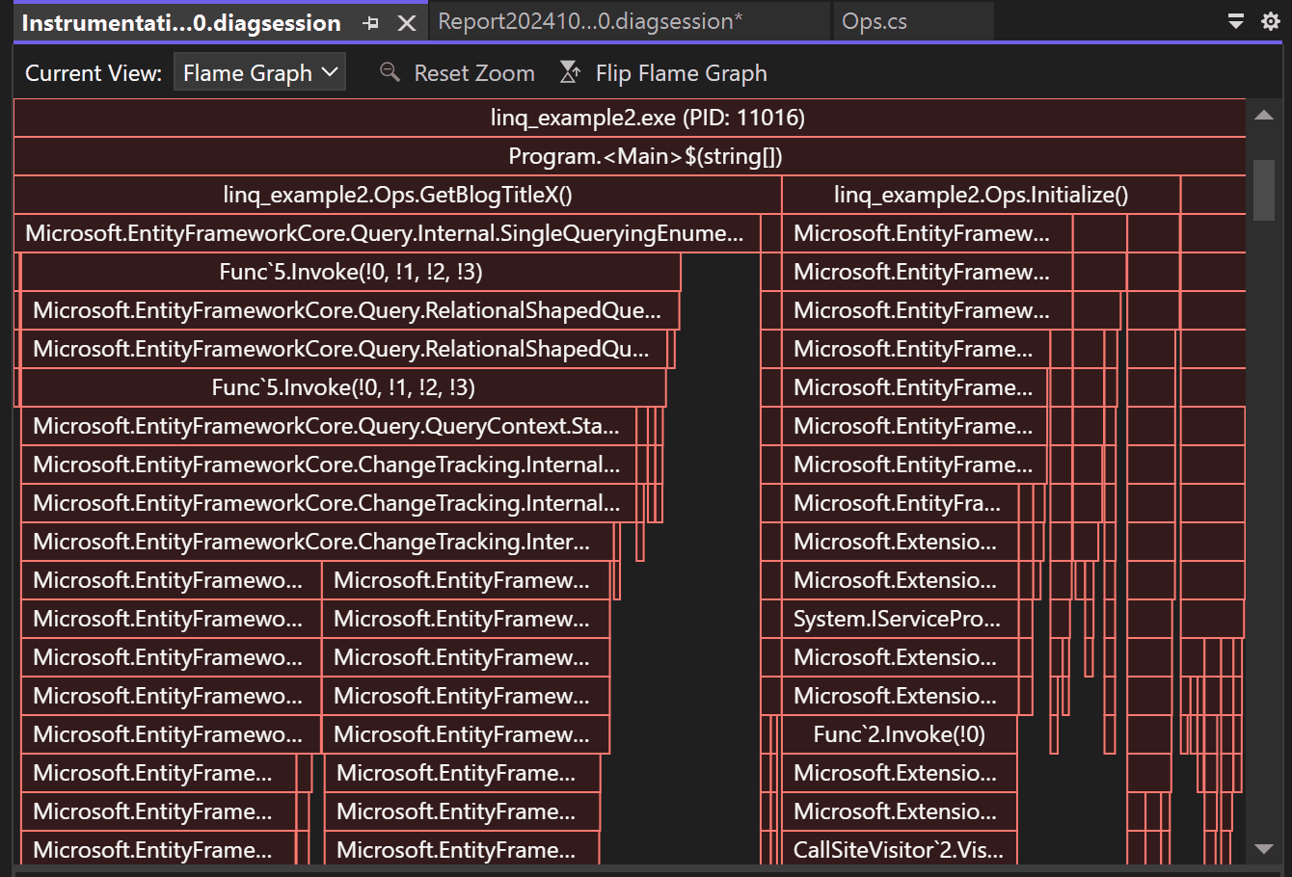

Slide 77
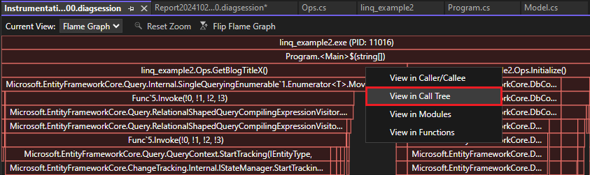
To view details about any node, select the node.
Choose Reset Zoom to return to the default view.
You can also navigate to different views in the profiling report by selecting a node, and then choosing an option such as View in call tree from the context menu.

Slide 78
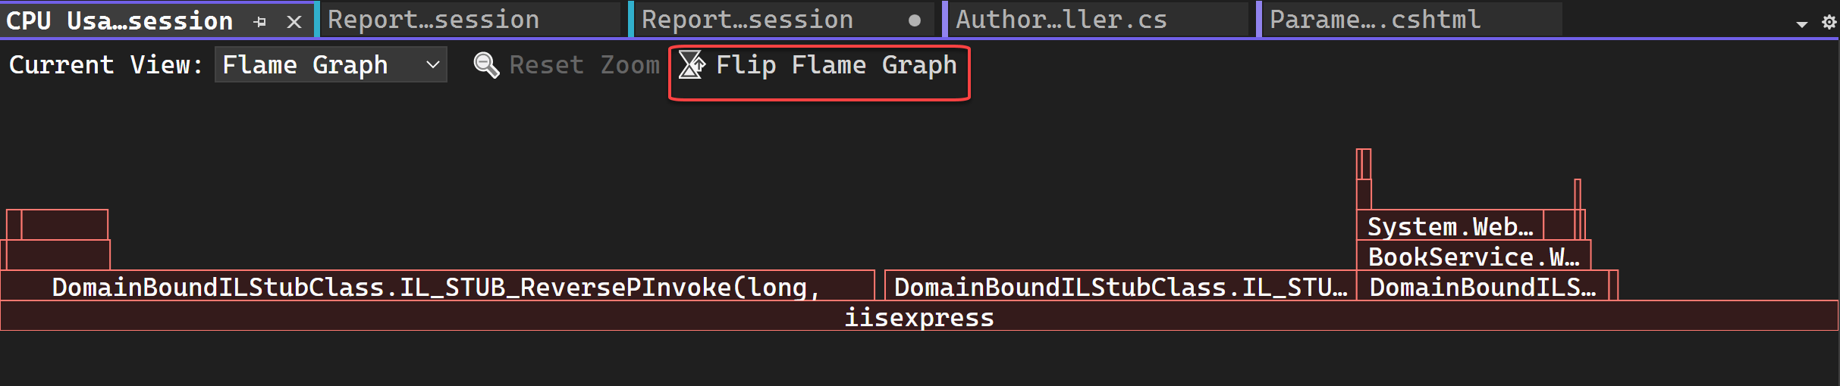
Flip the Flame Graph
By default, the flame graph in the tool is shown upside down or as an icicle chart, where the y-axis is counting stack depth downwards from zero at the top.
You can view a standard flame chart layout by clicking Flip Flame Graph.

Slide 79
Navigate in the flame graph
For a complex flame graph, you can zoom the visualization by selecting specific elements.
In the Flame Graph view, you can navigate by clicking on a node with a mouse or using the keyboard. In addition, the following keyboard shortcuts are supported.
Keyboard shortcut | Command
Tab | Go to any node
Up/Down arrow | Go to a node's parent or child
Right/left arrow | Go to a node's peer on the stack
Enter | Zoom in (select)
Escape | Zoom out

Slide 80
Understanding the call tree
profiling tools for CPU Usage and Instrumentation in Visual Studio include a call tree view that provides a visualization of the call paths in your application, along with performance data.
Sometimes, the call paths that appear in the Call Tree view may look different than you expect.
To interpret the data you see in the call tree, it helps to understand the common reasons for these differences when they occur.

Slide 81
Common reasons:
Release build optimizations --Release builds perform many optimizations such as inline function calls.
Inline functions don't appear in the call tree.
In some cases, release build optimizations may also generate unexpected code that appears in the call tree.
Asynchronous functions --Execute on their own thread independent of the call path, and they normally appear in a separate node.
For Instrumentation --Can configure options to view .NET async calls in a more intuitive way, within the call path where the async call was made.
Sampling of fast functions. For sampling (CPU Usage only), functions that execute very quickly may not get sampled, in which case these functions don't appear in the call tree.

Slide 82
Compiler generated code --Some operations generate code that isn’t intuitive.
For example, async/await patterns generate state machines.
Other examples include getters/setters, pattern matching, event handlers, query syntax for LINQ, source generators (for example, creation of source generators for json serialization), and other code features.
In these scenarios, some generated code may appear in the call tree.

Slide 83
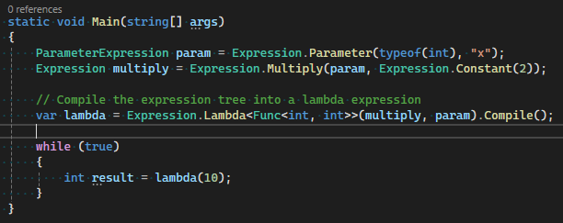
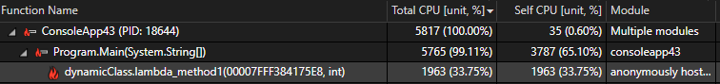
Dynamically generated code. Unlike compiler-generated code, dynamically generated code is compiled on the fly.
This isn't as common as compiler-generated code. The following code uses an expression tree and results in dynamically generated code.
Call Tree view shows that this work is happening in a generated method with a generated name, which might be unexpected.

Slide 84
Code that defers execution. For code that defers execution, such as LINQ, the call path can appear in unexpected ways if you're unfamiliar with how LINQ works. For example, if you use the following code:
// LINQ query to get all items less than 1,000,000
var query = list.Where(number => number < 1_000_000);
var count = query.Count();
May expect the call tree to show too much time spent in the Where statement, but the enumeration actually happens in Count, so Count may show up as a slower function in the call tree.
The following example is the opposite:
// LINQ query to get all items less than 1,000,000
var query = list.Where(number => number < 1_000_000).ToList();
var count = query.Count();
In this example, ToList forces the enumeration before Count, so the Count call is optimized and runs very fast. Instead, the Where statement takes the most time.

